Slide 1
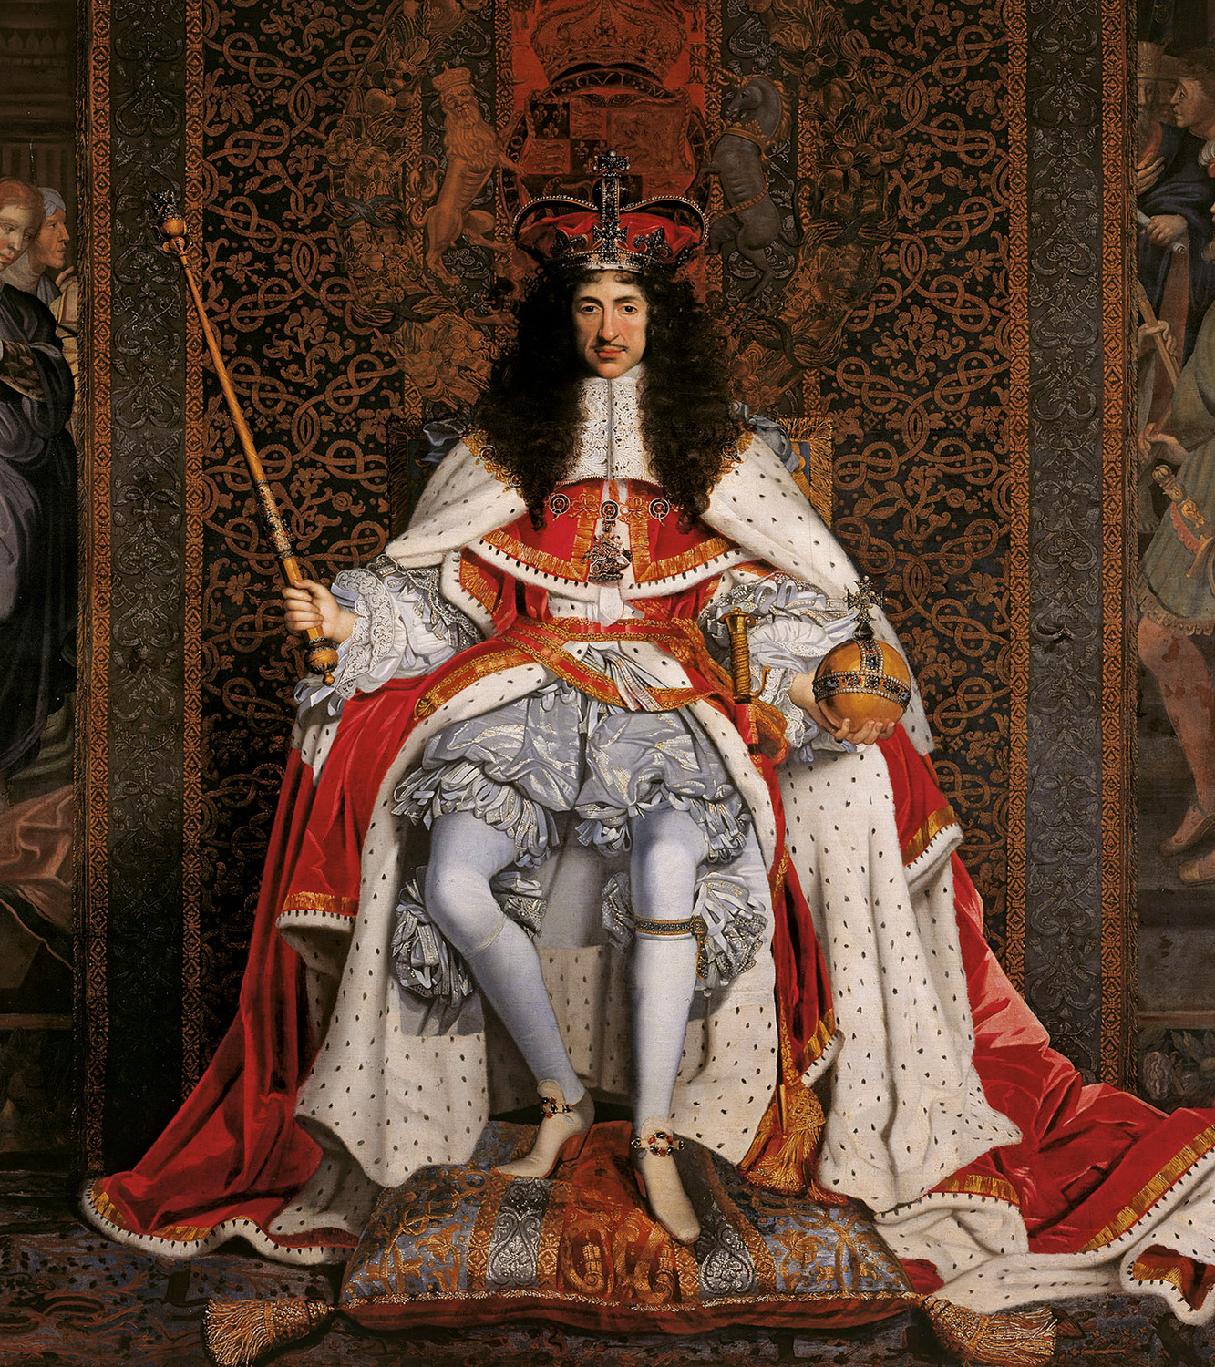
1660-1700 RestoratIon PerIod

Slide 2
The period begins with the RESTORATION of the Monarchy in bringing Charles II from his exile in France.
Brings with him the tolerant and artistic ways of Louis XIV’s court
Two distinct political parties resulted, the Whigs and the Tories
Whigs want to limit royal authority
Tories support absolute royal authority.
1688-89 The Glorious Revolution, James II deposed William of Orange became the monarch
The Age of John Dryden

Slide 3
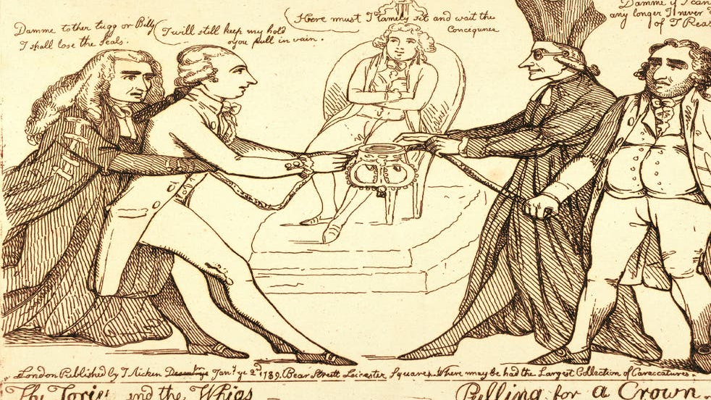
Whigs and Tories

Slide 4
A reading nation
Common interest: merchantalism, market trade
The colonial expansion
Slavery
Religion and politics, Catholics persecuted and banned from public,
Exclusion Bill

Slide 5
The literature of the Restoration
Intellect
Reason
Human is innately good (unlike Catholic belief)
Deism
Satire and politics
Restoration comedy, libertines and rakes
Philosophic skepticism

Slide 6
Samuel Butler, John Dryden, Rochester
Restraint, clarity, regularity and good sense.
French effect through Charles II.
Dryden brought the early modern literature to England.
He mixed traditional Shakespeare and Chaucer with European cosmopolitanism
Kept loyal to aristocratic heroic ideal: «the fierceful wars and faithful loves»
Nobility and romances revived
Restoration Comedy: top literary production of the period
COMEDY OF MANNERS, social behaviour, nasty stories, upperclasses, wit, humour
Discussions of moral decadence caused by the restoration comedy

Slide 7
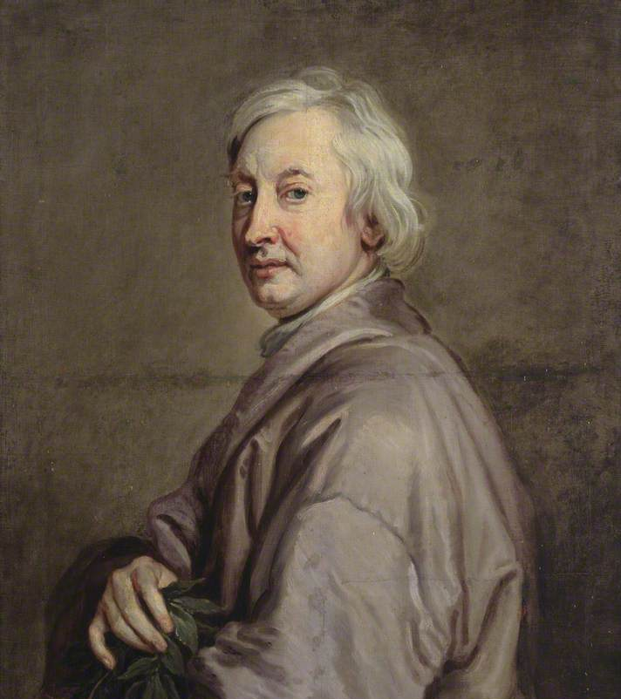
John Dryden (1631-1700)
Westminster School / Cambridge
Most Popular Works
Astraea Redux, 1660
Annus Mirabilis (poem), 1667
An Essay of Dramatick Poesie, 1668
Absalom and Achitophel, 1681
Mac Flecknoe, 1682
The Medal, 1682

Slide 8
«he found it brick, he left it marble» S.Johnson on Dryden
Loyal to monarchy, also wrote poems for Cromwell before
Got good education
Poet laurete
Dramas; theme of love and honour, comedy of manners
An Essay of Dramatic Poesy
«The father of English criticism» Samuel Johnson
Verse satire, his masterpieces
Mac Flecknoe, Absalom and Achitopel, The Medal
Heroic couplet
Later lost position because he was a Catholic, turned to translation to earn money

Slide 9
Absalom and Achitopel
King David – Charles II
Absalom – Duke of Monmouth
Achitopel – The Earl of Shaftesbury
Popish Plot
Monmouth Rebellion

Slide 10
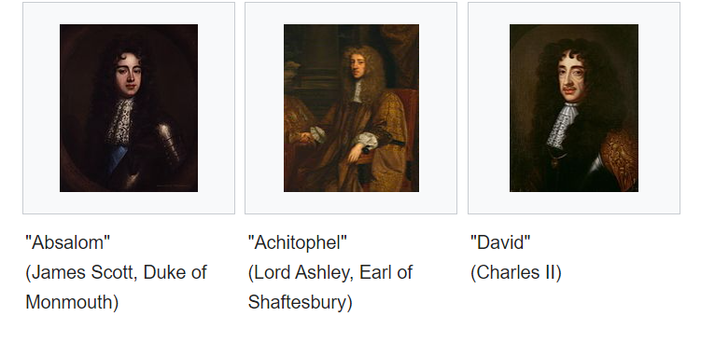

Slide 11
Divine rights of kings
Power and ambition

